Slide 1
Automation Framework

Slide 2
Automation Scope :
Personal Details form Validation. {Title , Name , Date of Birth, Email}.
Quote Generation
UI Validation , Proper Error messages are displayed or not.
Cross Browser Testing & Mobile Testing.
Regression Testing

Slide 3

Technologies used
Selenium WebDriver with Java Language binding
Cucumber 6.x JVM library
WebDriverManager
JDK 1.8 5. Maven (Build tool)
Maven Plugins
Cucumber extent report 6 adapter
JUnit 4.x library
Log4j
GIT HUB - Git Repo
Eclipse (IDE)

Slide 4
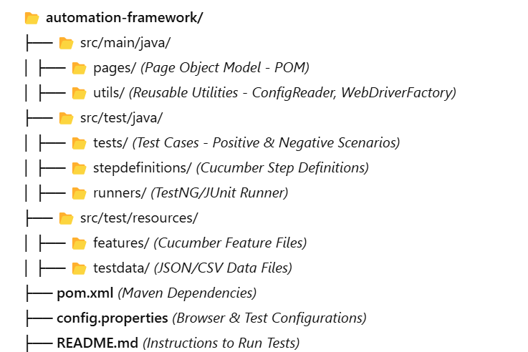
Framework :

Slide 5
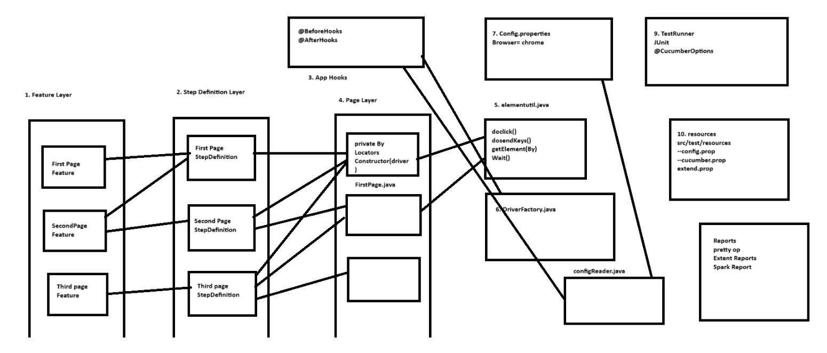
Framework Outline

Slide 6
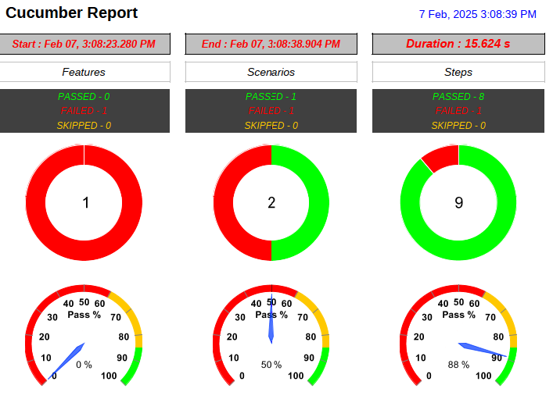
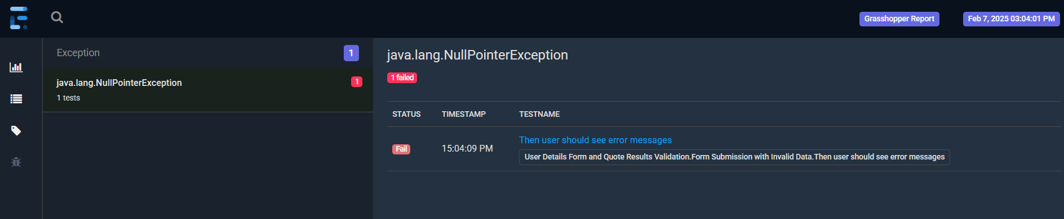
Reports
Extent pdf reports
Spark Report(HTML)
file:///C:/Users/kisho/git/quoteFramework/ActiveFramework/test-output/SparkReport/Index.html#

Slide 7
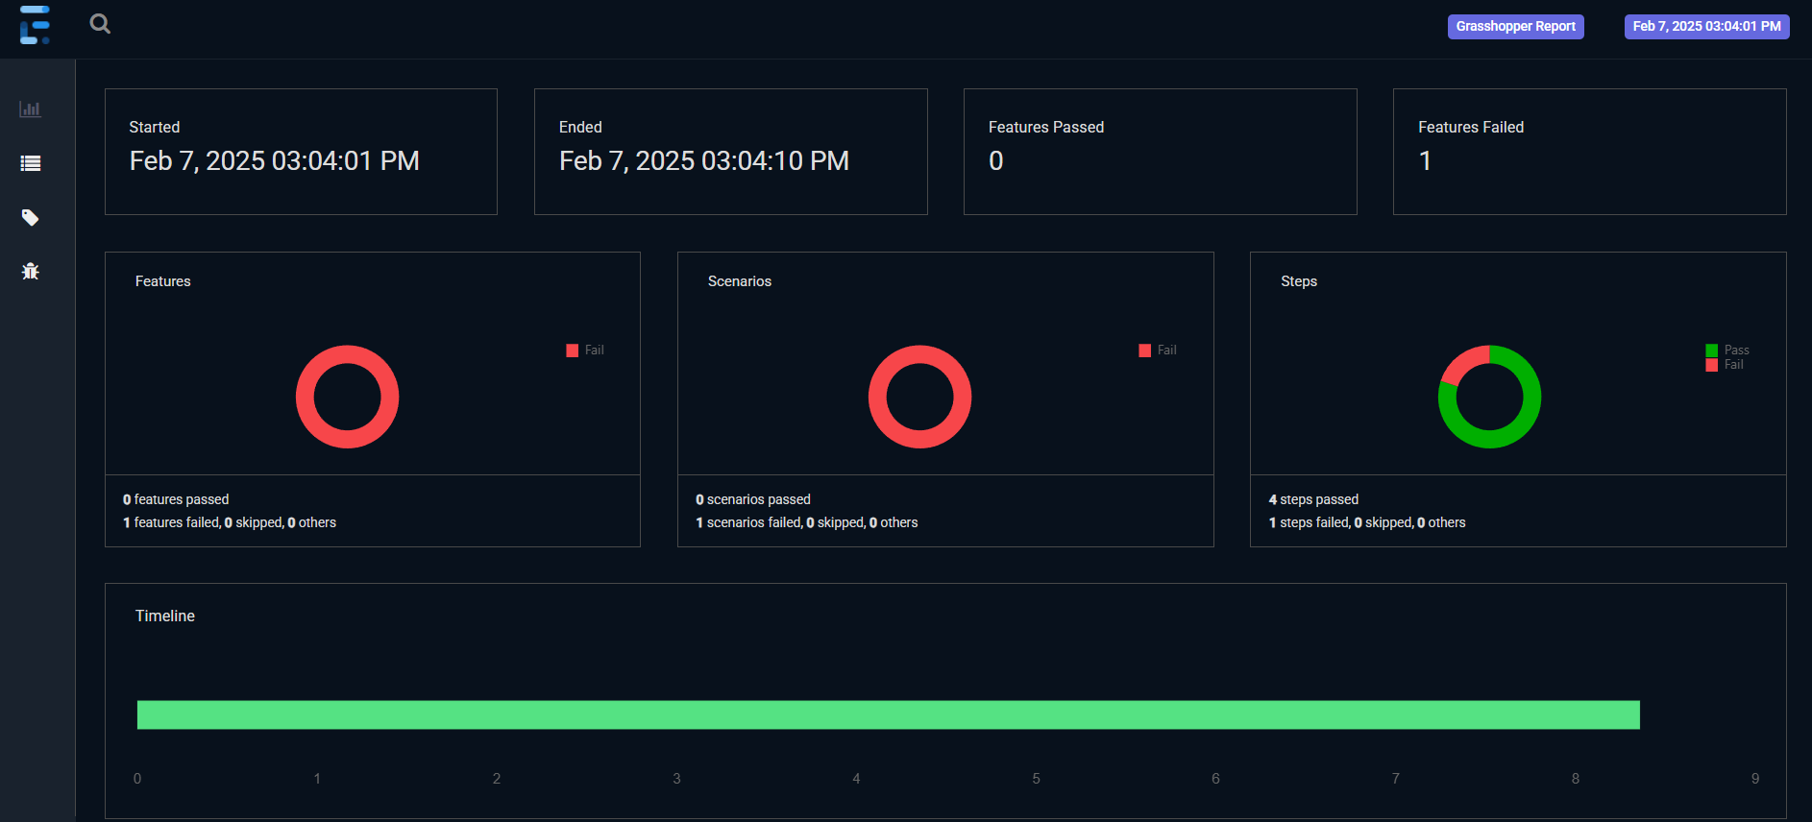
HTML Report

Slide 8
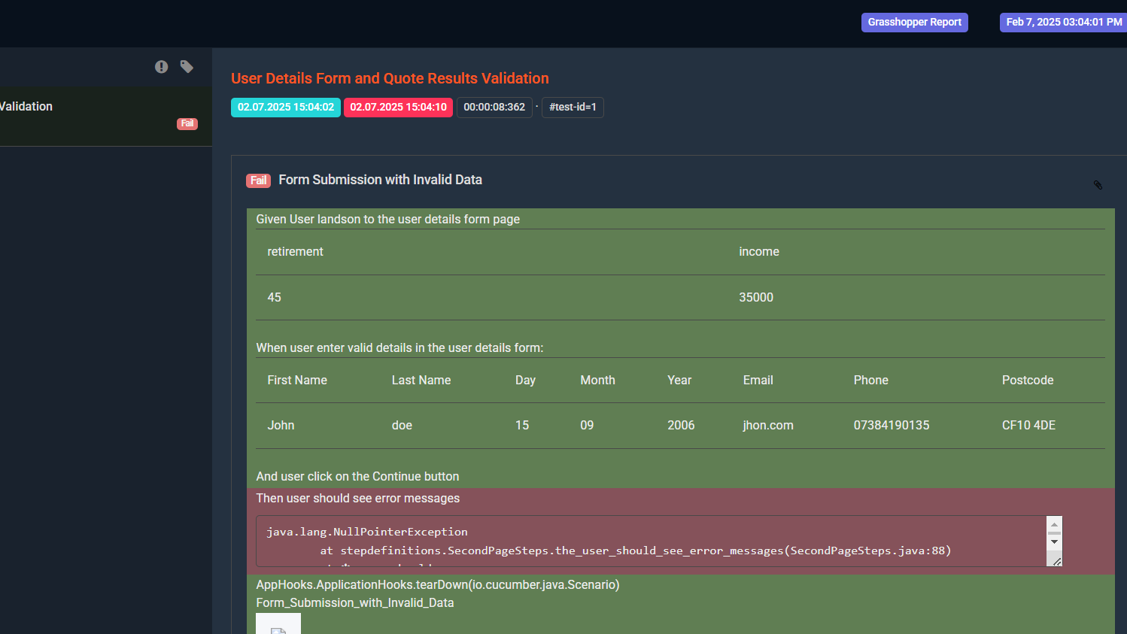

Slide 9
Thank you!

